Slide 1
Transposing data
Release Date: DD-Mmm-YYYY

Slide 2
Transposing data
Transposing is converting variables to observations and vice versa
Multiple ways of restructuring and transposing data
Proc Transpose
DATA step – Arrays and DO Loops
Notes:
So many times we need to take our data and turn it around. One of the reasons that this is done is that it is more efficient to store your data in a vertical format and processing the data is easier in a horizontal format.
That means that we need to change the format of the data before we process or analyze it.
The transpose procedure restructures the data by changing the variables into observations. How this is done and what variables are chosen to transform are determined by the options that are chosen when running the procedure.
We classify data as either vertical or horizontal. The format in which we store data is very different from the format that we need to analyze the data. There are very good reasons why we need to be able to change the layout of the data based on what we need to do with the data. The best method of data storage is to keep it in a vertical format.

Slide 3
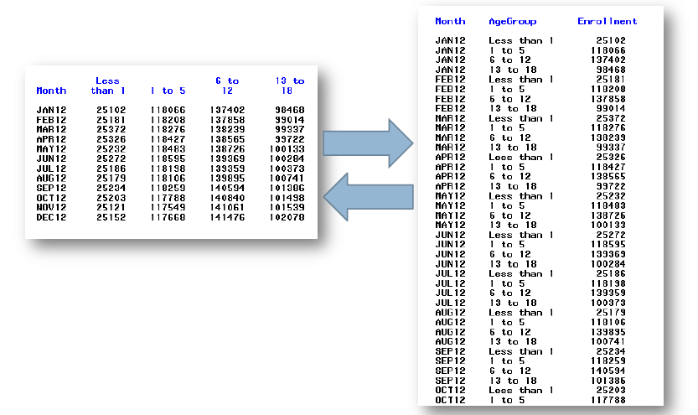
Transposing data

Slide 4
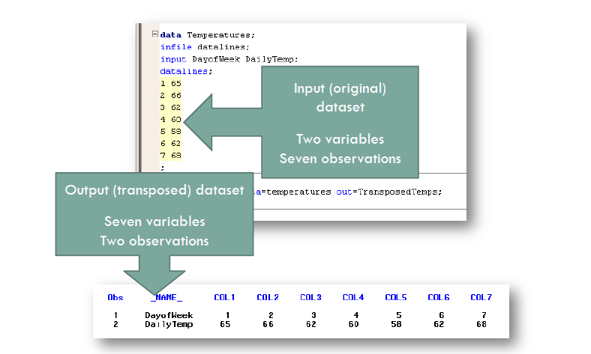
Transposing data – basic example

Slide 5
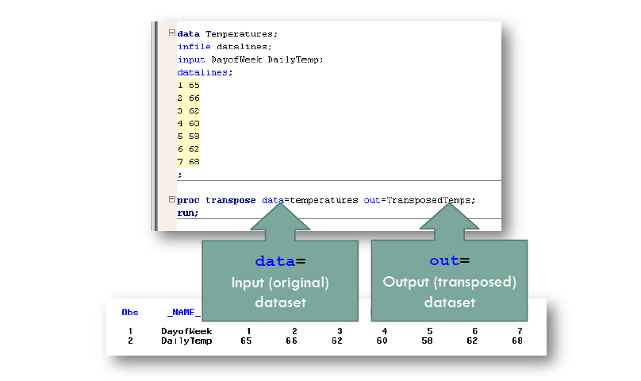
Transposing data – basic example

Slide 6
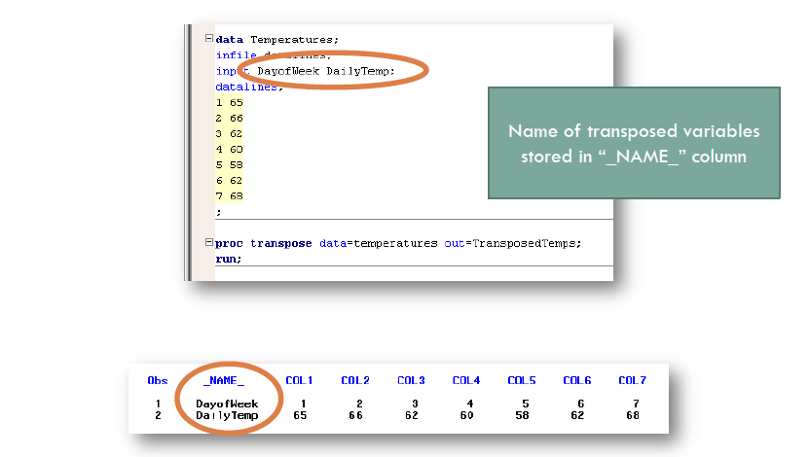
Transposing data – basic example

Slide 7
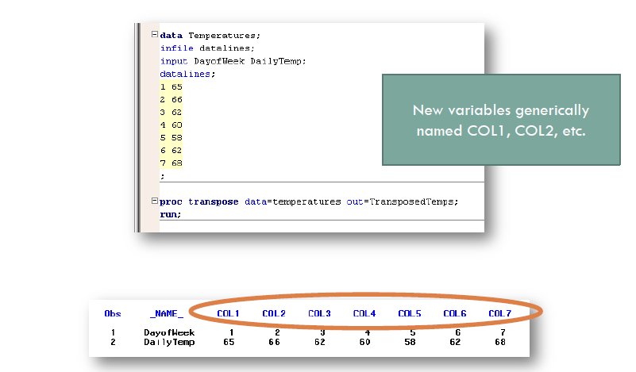
Transposing data – basic example

Slide 8
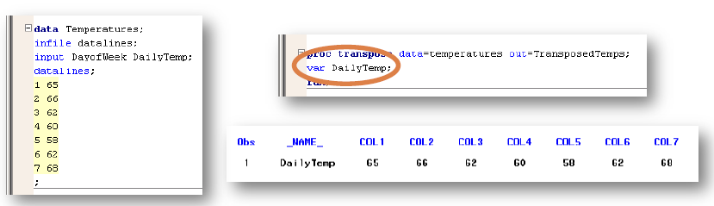
Var statement
The var statement specifies which variables should be transposed
If omitted, by default PROC Transpose will only transpose numeric variables

Slide 9
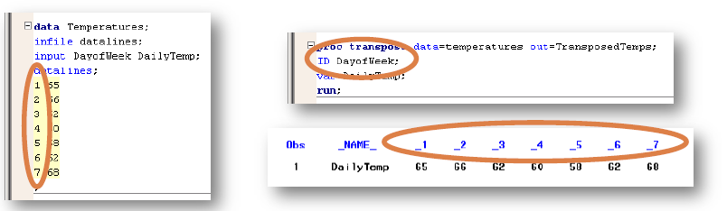
ID statement
The ID statement specifies which variables should be used to name the new columns
If the value is not a valid variable name (e.g., starts with a number), SAS will convert it to valid name (e.g., leading underscore)

Slide 10
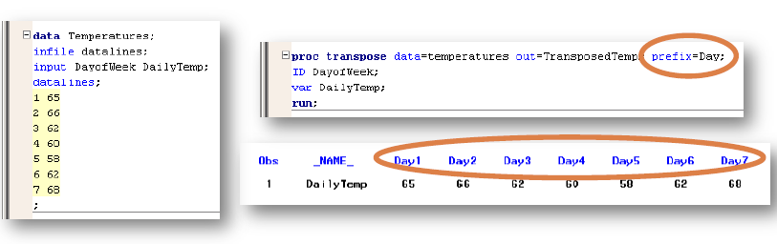
ID statement
The variable names can be modified with the
prefix=, delimiter=, or suffix= options

Slide 11
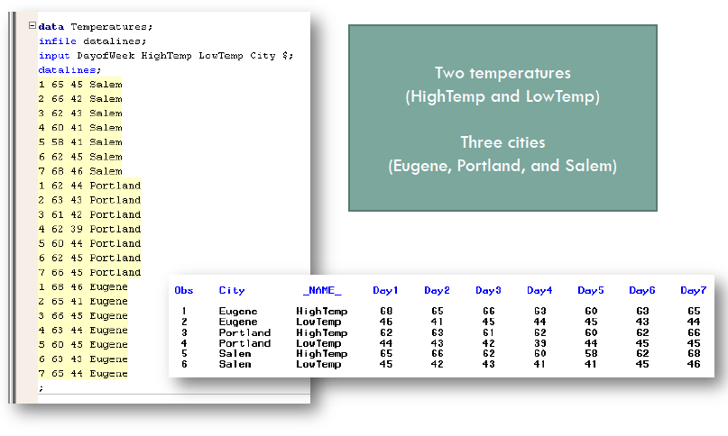
Transposing data – By groups

Slide 12
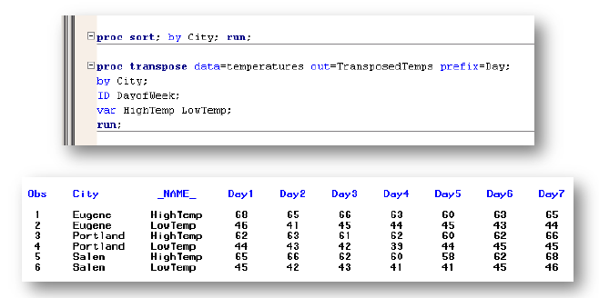
BY statement
Can specify more than one BY group variable
Data must be sorted by BY group variable(s)

Slide 13
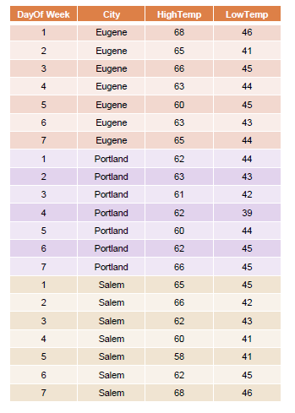
BY statement

Slide 14
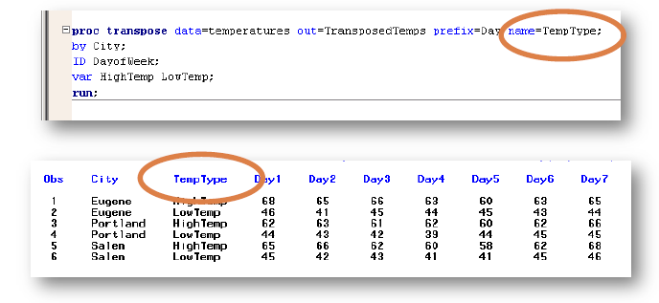
NAME= option
Use the name= option to name the variable containing the name of the transposed variable (NAME_ column)

Slide 15
PROC TRANSPOSE : BY Statement
Param | W1 | W2 | W3 | W4
SBP | 80 | 85 | 90 | 86
DBP | 120 | 119 | 130 | 104
proc transpose data=a out=b (drop=_label_) name=visit prefix=var;
by param;
run;
In this example, we can transpose the records by region with the addition of a BY statement to our PROC TRANSPOSE code:
Variables will be transposed within BY-groups, and the resulting data set looks like:
Param | Visit | Var1
SBP | W1 | 80
SBP | W2 | 85
SBP | W3 | 90
SBP | W4 | 86
DBP | W1 | 120
DBP | W2 | 119
DBP | W3 | 130
DBP | W4 | 104

Slide 16
Proc Transpose : ID Statement
To convert the data on the last slide back to horizontal form.
Param | Visit | Var1
SBP | W1 | 80
SBP | W2 | 85
SBP | W3 | 90
SBP | W4 | 86
DBP | W1 | 120
DBP | W2 | 119
DBP | W3 | 130
DBP | W4 | 104
Visit | SBP | DBP
W1 | 80 | 120
W2 | 85 | 119
W3 | 90 | 130
W4 | 86 | 104
proc transpose data=a out=b (drop=_name_) prefix=var;
id param;
idlabel param;
Var var1;
run;
The IDLABEL statement can be used for just that purpose- the value of the variable specified in an IDLABEL
statement becomes the label of the output data set variable. There is one limitation on the use of an IDLABEL statement- it must be specified in conjunction with an ID statement.
The transposed variables will be named VAR1-VAR3, but the variable labels become as shown above.

Slide 17
Examples of Proc Transpose with clinical data

Slide 18
Thank You

